Slide 1


Indian House Price Prediction Using Linear Regression & XGBoost

Slide 2
Introduction
Presented By: Jay Satish Gunjal
Class – MSc (CS)
Roll No: 2574033
College: Modern College of Arts, Science & Commerce, Pune

Slide 3
Working Principle of Algorithms
Linear Regression:
Computes weighted sum to predict price
Best-fit line minimizes error
XGBoost Regressor:
Sequential decision trees
Boosting reduces previous errors

Slide 4
Mathematical Intuition
Linear Regression Formula:
ŷ = wᵀx + b
Mean Squared Error:
MSE = (1/n) Σ (y − ŷ)²
XGBoost Prediction:
ŷ = Σ fₜ(x)

Slide 5
Dataset Details
Dataset: Indian Housing Dataset
Features:
Area, BHK, Bathrooms, Parking,
Furnishing, Location Score, City
Target: Price (Lakhs ₹)

Slide 6
Preprocessing Steps
One-hot encoding for City
Scaling using StandardScaler
Train-test split (80/20)
Cleaning & feature preparation

Slide 7
Code Workflow Overview
Load dataset
Show summary statistics
Visualize price distribution
Encode & scale features
Train LR & XGBoost
Evaluate using RMSE & R²
Plot graphs

Slide 8
Performance Evaluation
Linear Regression:
RMSE = 22.29
R² = 0.96
XGBoost:
RMSE = 12.87
R² = 0.99
XGBoost gives best accuracy

Slide 9
Model Comparison
Linear Regression:
• Simple baseline model
• Less accurate
XGBoost:
• Handles non-linearity
• Highest accuracy and fit

Slide 10
Key Findings
City, Area, BHK most important features
XGBoost outperforms LR
Feature scaling improves results

Slide 11
Input/Output Screens
Inputs:
Dataset CSV
Housing features
Outputs:
RMSE & R² scores
Prediction graph
Feature importance

Slide 12
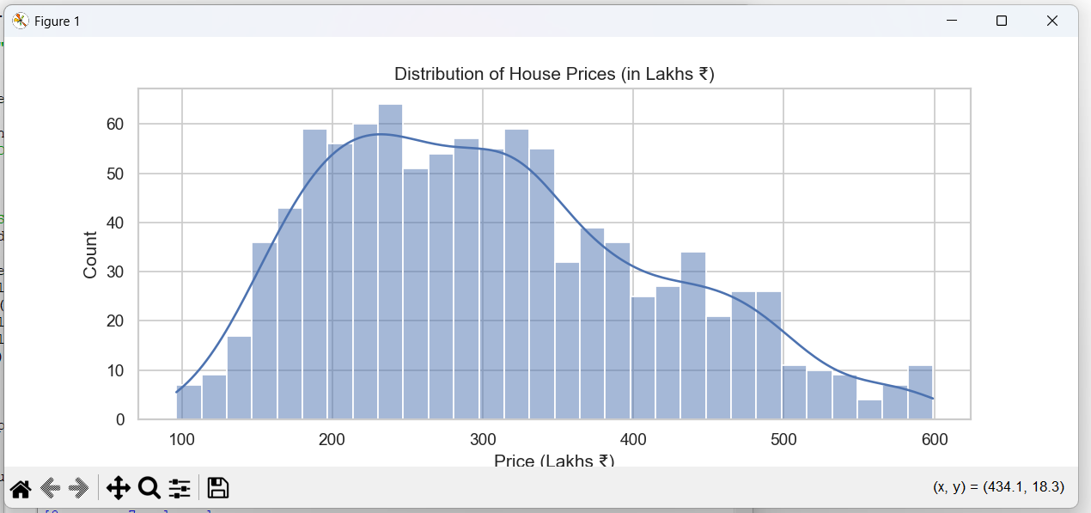
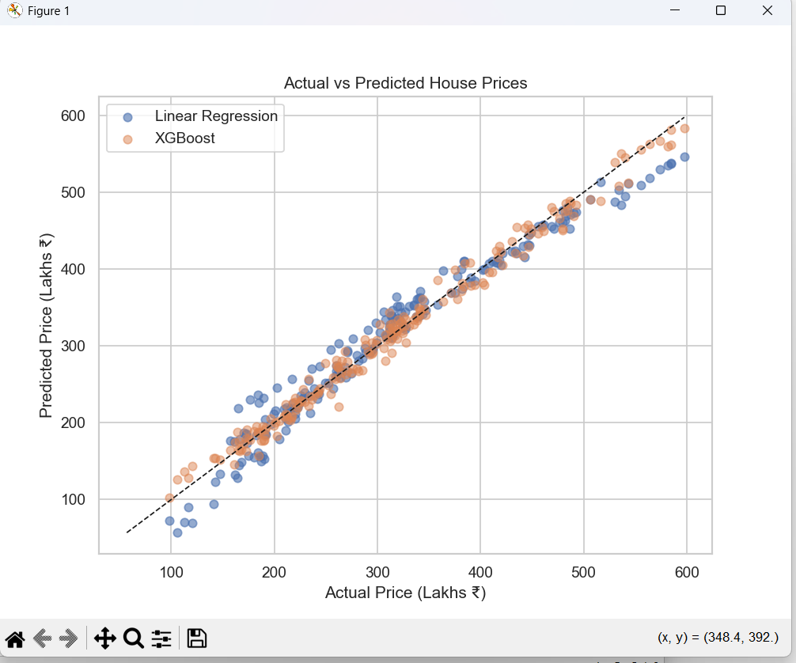

Slide 13
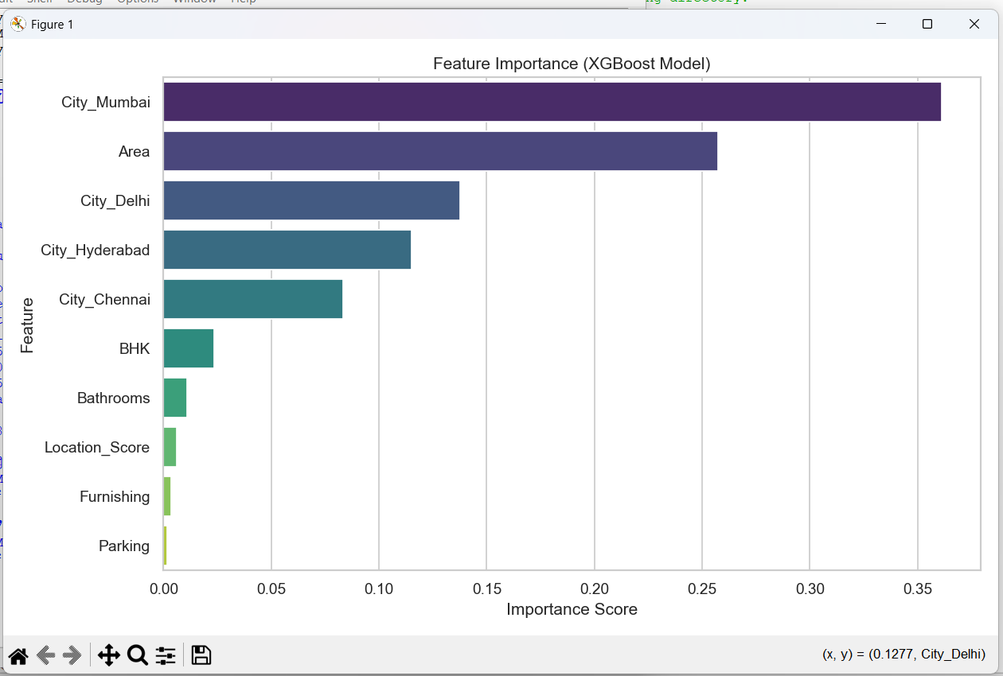

Slide 14
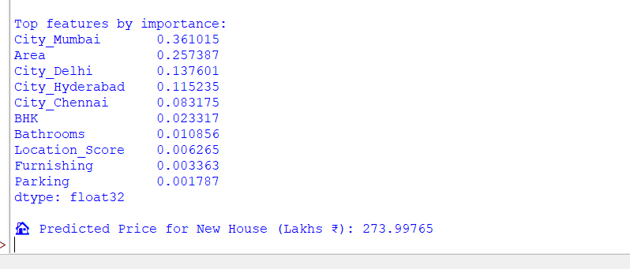

Slide 15
Data Dictionary
Area – House size
BHK – Bedrooms
Bathrooms – Washrooms
Parking – Parking availability
Furnishing – Furnish level
Location Score – Locality rating
City – Location
Price – Target variable

Slide 16
Graphical Outputs
Insert:
Price Distribution
Actual vs Predicted
Feature Importance

Slide 17
Limitations
Limited dataset
No location coordinates
No advanced tuning
No real-time factors

Slide 18
Final Conclusion
ML predicts prices accurately
XGBoost best performing model
Can be improved with more features and tuning

Slide 19
Thank You

